Slide 1

#1
Pengenalan Python & Anaconda

Slide 2

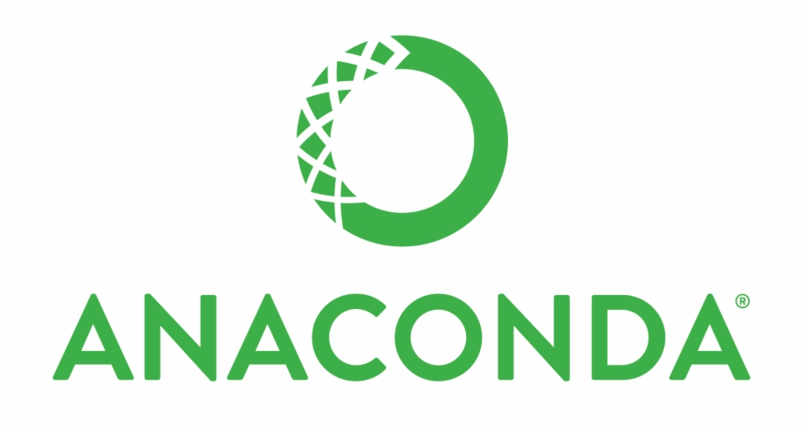
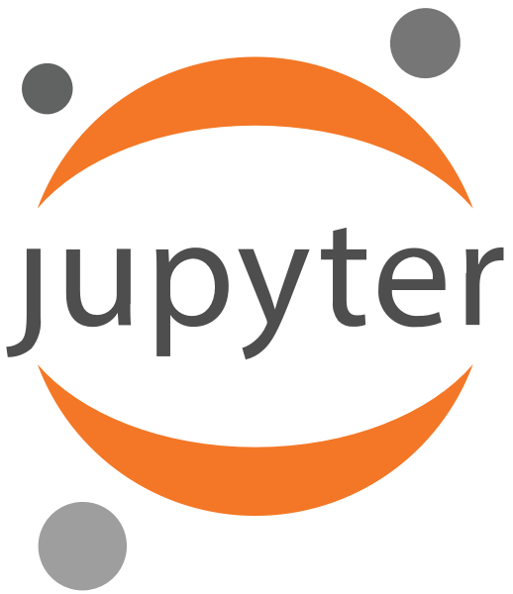


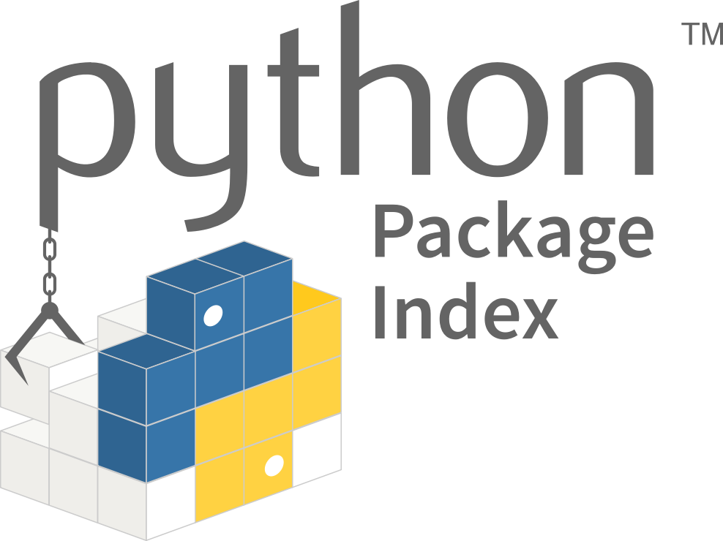
Tools, Library & Pemrograman
Languange
Package
Development Tool
Library
Python
Jupyter Lab
PIP
Notes:
https://www.sas.com/en_us/insights/analytics/computer-vision.html

Slide 3
Tools, Library & Pemrograman
Languange
Python is an interpreted, high-level and general-purpose programming language.
Created by Guido van Rossum and first released in 1991
Python

Slide 4

Website Anaconda
Package
Notes:
https://www.anaconda.com/

Slide 5
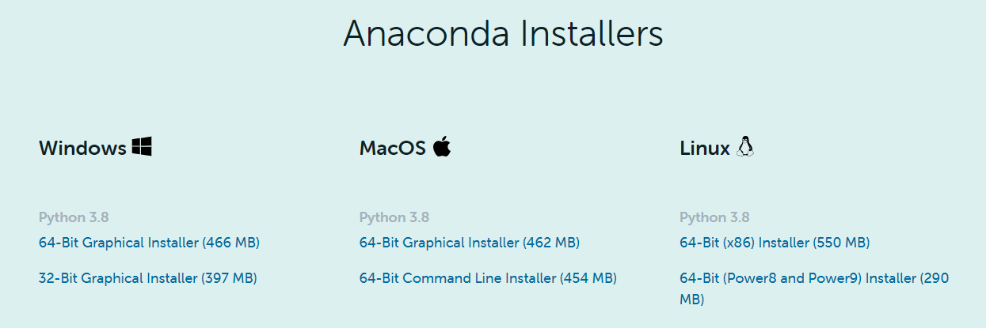
Download Anaconda
Package
Notes:
https://www.anaconda.com/products/individual

Slide 6
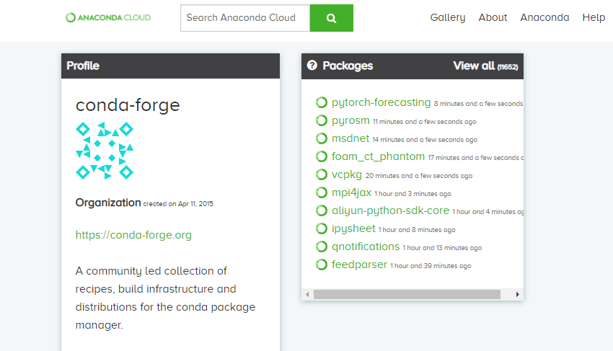
Conda Package
Package
Conda Forge
Notes:
https://anaconda.org/conda-forge

Slide 7
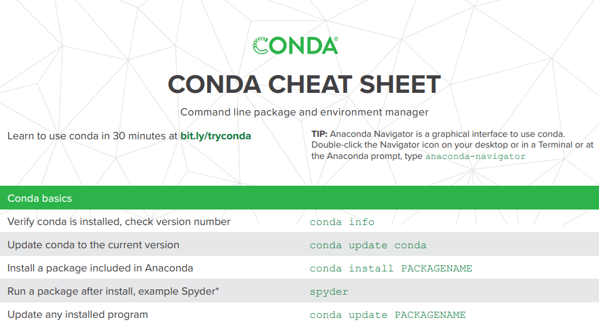
Anaconda Cheat Sheet
Package
Conda Cheat Sheet
Notes:
https://anaconda.org/conda-forge

Slide 8
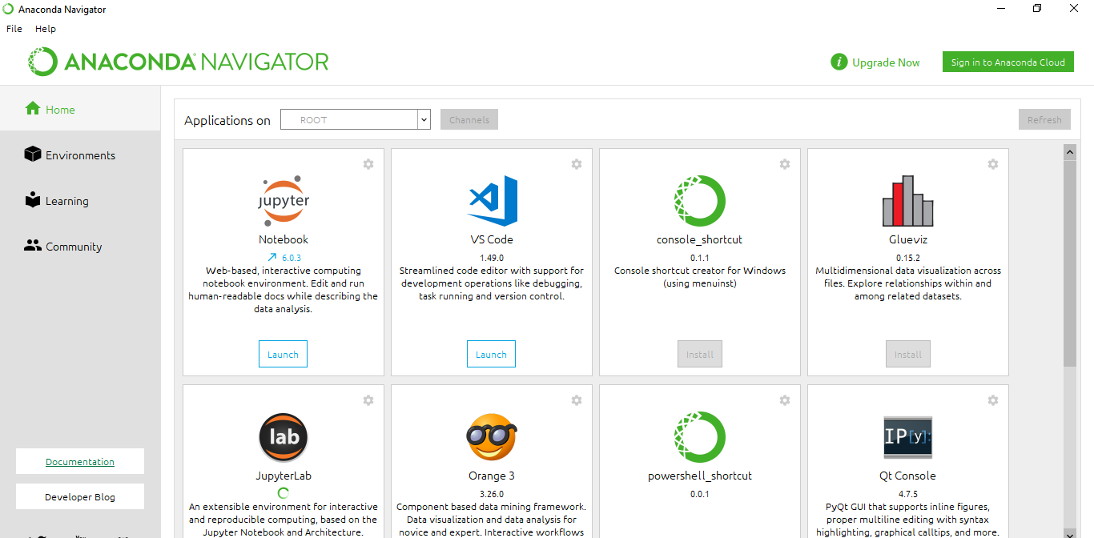
Anaconda Navigator
Tool
Anaconda Navigator
Notes:
https://anaconda.org/conda-forge

Slide 9
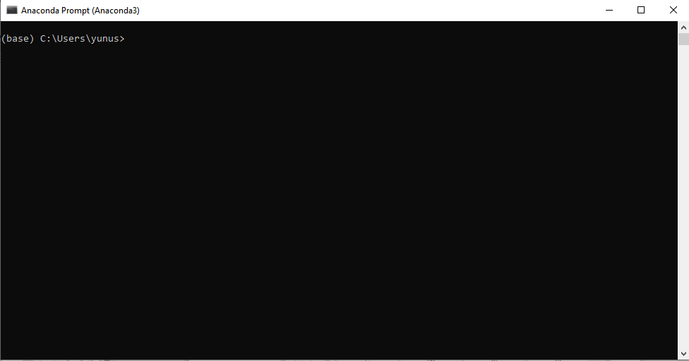
Anaconda Prompt
Tool
Anaconda Prompt
Notes:
https://anaconda.org/conda-forge

